Slide 1




DOING BUSINESS WITH CLARK COUNTY
Department of Finance
Purchasing & Contracts Division
500 S. Grand Central Parkway, 4th Floor
Las Vegas, Nevada 89155
(702) 455-2897

Slide 2

Table of Contents
Who is Clark County
Opportunity Websites
Legal Authority
What We Purchase
Advertisement of BIDs/RFPs
Submittal of BIDs
Bid/Proposals Review and Awards
Informal Purchasing Guidelines
Purchase Orders/Invoices
Purchasing Staff Contact and
Assignments
Questions

Slide 3

CLARK COUNTY DEPARTMENTS
Department of Social Services
Department of Family Services
Clark County Fire Department
Clark County Parks and Recreation
Clark County Detention Center
Eighth Judicial Court & Family Court
Public Works and Real Property Management
Clark County Coroner

Slide 4
CLARK COUNTY DEPARTMENTS
Animal Control and Code Enforcement
Public Defender
Public Administrator and Public Guardian
Recorder’s Office
Clark County Elections Department
County Clerk
Clark County Business License

Slide 5
OTHER DIVISIONS
Clark County Water Reclamation District
Department of Aviation – Harry Reid Airport
University Medical Center
* These divisions utilize their own purchasing departments.

Slide 6

PURCHASING AND CONTRACTS’ WEBSITE
Important information related to the purchasing process for Clark County is available 24 hours a day, 7 days a week by visiting the Purchasing & Contracts webpage at:
www.clarkcountynv.gov/purchasing
Supplier Registration: http://ngemnv.com
This home page offers links to the following information:
Current Contracting Opportunities
P.O. Terms and Conditions
Nevada Government eMarketplace (NGEM) Supplier Registration
Regional/Business Development Advisory Council (RBDAC)/(BDAC)
Request for Public Records forms
Links to Opportunities with Other Entities/Agencies

Slide 7


Register as a Supplier at
www.NGEMNV.com

Slide 8
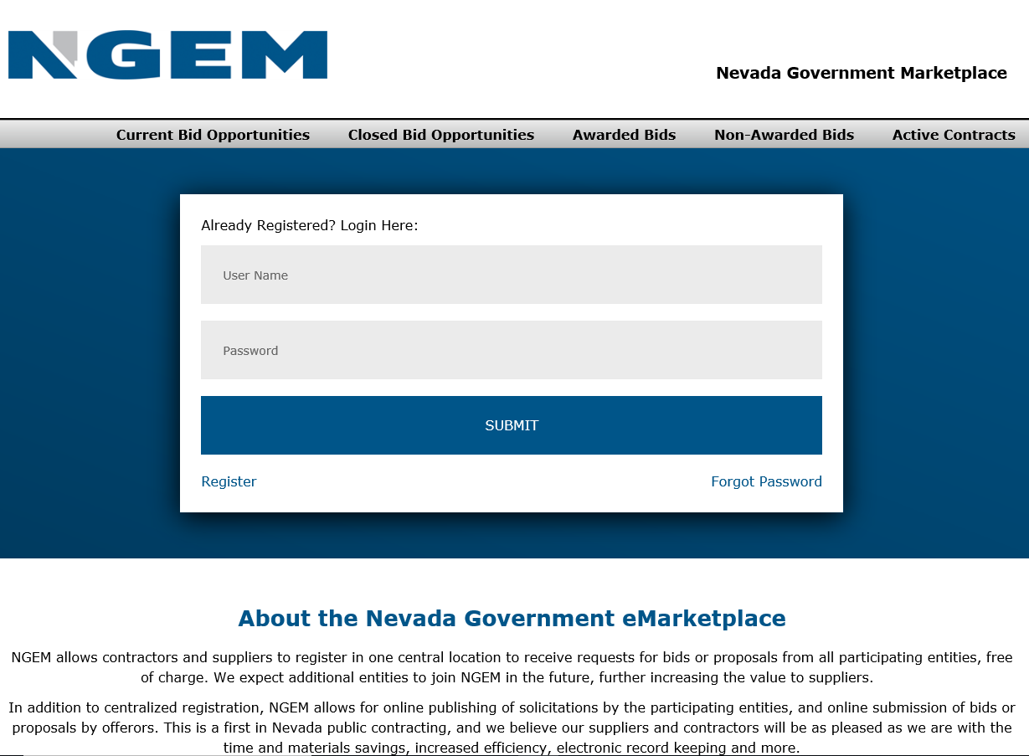

Slide 9

LEGAL AUTHORITY
Nevada Revised Statutes Chapter 332 (Purchasing Act), for the purchase of Goods and Services and Chapter 338, for the award of Construction Projects. County Ordinance Resolutions and Fiscal Directive No. 6, create the legal authority for the operations of Clark County Purchasing and Contracts.
The Board of County Commissioners (BCC) acts as the governing body for Clark County. The Commission meets on the first and third Tuesday of each month, with special meetings called from time to time for specified items.

Slide 10


PROFESSIONAL SERVICES
The Service Provider is required to hold a Clark County business license or a Limited Vendor Business Registration, a professional license, or specialized certification is usually required to perform the services. Professional Services are exempt from the competitive bidding process; however, it is Clark County’s policy to solicit proposals using a formal Request for Proposal process, whenever possible.
GOODS
All of the commodities required to develop and maintain new and existing facilities and department operation. Goods valued at an annual usage greater than $100,000 are solicited using a formal bid process.
WHAT WE PURCHASE
GENERAL SERVICES
The Service Provider is required to hold a Clark County business license and no special certification or license is typically required to perform the services. General Services valued at an annual usage greater than $100,000 are solicited using a formal bid process.
CONSTRUCTION
Construction encompasses vertical and horizontal construction projects for Public Works for all departments. Construction projects valued greater than $100,000 are solicited using a formal bid process.

Slide 11

ADVERTISEMENT OF BIDS/RFPS
GOODS AND GENERAL SERVICES – In accordance with Nevada Revised Statutes Chapter 332, any bid for Goods or Services that exceeds $100,000 shall be advertised in a newspaper, published, and having a general circulation within the County. Clark County uses the NGEM system for the solicitation and receipt of bids.
CONSTRUCTION – In accordance with Nevada Revised Statutes Chapter 338, any bid for construction that exceeds $100,000, shall be advertised in a newspaper, published, and having general circulation within the County. Clark County uses the NGEM system for the solicitation and receipt of bids.

Slide 12
ADVERTISEMENT OF BIDS/RFPS
GUIDELINES – The advertisement must be published at least once and not less than 7 days before a bid opening. Clark County Purchasing and Contracts places all advertisements in the Legal Notices section of the Las Vegas Review Journal.
PROFESSIONAL SERVICES – In accordance with Nevada Revised Statutes 332.115, professional services are considered a competitive exception, however pursuant to internal policies and procedures, Clark County may solicit these services through a Request for Proposal or Request for Qualifications.

Slide 13

SUBMITTAL OF BIDS/PROPOSALS
Bids/Proposals are received and publicly opened or unsealed on the date and time specified in the bid document.
Bids/Proposals for Construction Projects are generally opened at 2:15:00 p.m. on the date specified and Bids/Proposals for Goods, General Services and Professional Services are generally opened or unsealed at 3:00:00 p.m. on the date specified.
Once sealed Bids/Proposals are received, they are evaluated to determine if each bid was submitted in accordance with the solicitation document and its’ specifications.

Slide 14
SUBMITTAL CHECKLIST

Slide 15
REVIEW BIDS OR PROPOSALS RECEIVED
Bid/Proposal submitted on time
Bid/Proposal properly completed and signed
Discount payment terms offered
All Specifications and Qualifications have been met
Any exceptions taken or noted
All Addendum acknowledged
For proposals, determination is made using graded evaluation criteria and possibly oral presentations.
For bids, low responsive and responsible bidder is a two-prong process. Lowest cost received from qualified bidder.

Slide 16
AWARD RECOMMENDATION
BIDS
Award recommendations are made based on the Lowest Responsive and Responsible Bid submittal. The determination may involve all or some of the following factors:
Responsive: Bidder’s compliance with all requirements of the solicitation documents
Responsible: Bidder’s capacity and competence to provide the solicited service and/or products
Price
Conformity to Specifications
Financial ability to meet the contract terms
Previous Performance
Bidders Facilities and Equipment
Experience
Delivery Time
Discount Payment Terms

Slide 17
AWARD RECOMMENDATION CONT’D
RFP
Award recommendations are made based upon the highest ranked proposal submitted as a result of proposal completeness, presentations and/or oral interview and best respondent suited to fulfill the requirements of the RFP. Price in general is a last factor and is negotiated.
An award resulting from a Bid or Request for Proposal may require mandatory submittals as defined in the solicitation document, such as:
Before recommendation for award:
Proof of Specialty Licensure
Evaluation of proposed personnel or equipment to be used
Disclosure of Ownership/Principals Form
Clark County Business License or Limited Vendor Business Registration
Prior to final award:
Insurance Documents
Bonds

Slide 18
AWARD OF CONSTRUCTION BID
Documents required to be submitted with Bids at opening:
Bid Bond (5% of total Bid amount)
5% Sub-Contractor’s List
Documents required to be submitted after Bids open:
1% Sub-Contractors List (three apparent low bidders-2 hours after opening)
Clark County Business License
And any other documents required per the Bid document
Documents required prior to final award:
Required Insurances (General Liability, Automobile Liability, Worker’s Compensation and sometimes Underground Explosion)
Performance Bond
Labor and Material Payment Bond
Guaranty Bond

Slide 19
REJECTION OF BID SUBMITTALS
The County reserves the right to reject any and all Bids received and the right to waive any minor informality or irregularity. A common error that may result in the rejection of any bid includes such issues as:
The bid is not submitted before the closing date and time specified.
The Bidder’s Statement of Authority to Submit a Bid is not signed and uploaded with the bid document.
The Bidder submits a bid with a material exception to the bid specifications.
All Addendums are not acknowledged.
The Bidder does not include ALL required documents as outlined in the bid.
Evidence of collusion among Bidders.
No responsive and responsible bids were received.

Slide 20
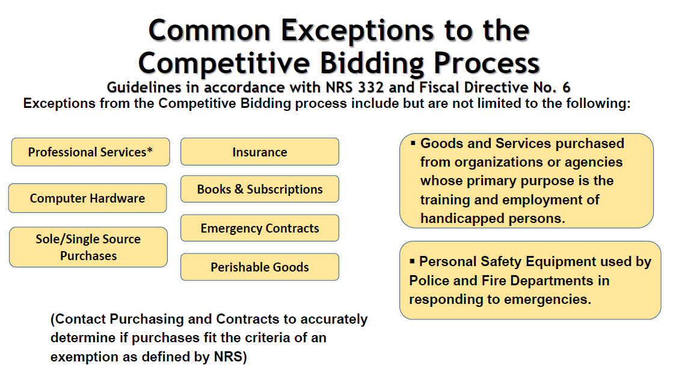

Slide 21
INFORMAL SOLICITATIONS OR QUOTES
These are for all of the same purchases above, but the total cost falls below the dollar threshold necessary to compete formally.
Clark County may use its own quote form or request bidder complete on their own quote form.
All quote forms must be completed in their entirety and submitted by the due date and time required.
If you have any questions regarding the specifications or requirements, contact the Clark County employee of record listed on the quote form to discuss your concerns.

Slide 22
SAMPLE QUOTE FORM

Slide 23
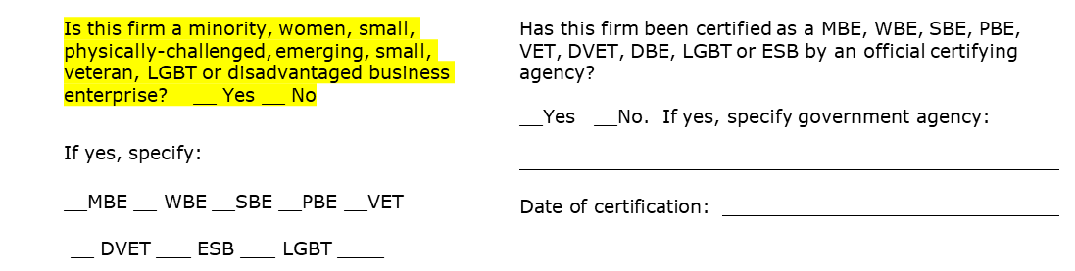
SAMPLE QUOTE FORM (CONT.)
CLARK COUNTY BUSINESS LICENSE NUMBER ­­­­­­­­­­­­­_______________________________________
STATE OF NEVADA LICENSE NUMBER ______________________________________________
NEVADA STATE CONTRACTORS BOARD LICENSE NUMBER ___________________________
NEVADA STATE CONTRACTORS BOARD LICENSE BOND LIMIT ________________________
________________________________ ________________
Authorized Signature Date
________________________________ _________________________
­­­­­­­­­­­­­­­­­­Printed Name Title
(Lack of signature by an authorized representative may result in rejection of submittal)

Slide 24
PURCHASE ORDERS AND INVOICES
All purchases must be made with an authorized Purchase Order.
You should not proceed on any verbal order, deliver goods or services, or invoice for any goods or services without first having been given an official Purchase Order document or the Purchase Order number, or a signed contract.
Invoices should contain the following:
Clark County Purchase Order Number and Work Order Number, when applicable.
Company Name, Address, Telephone Number and Contact Name.
Invoice Number
Itemized description of products delivered or services rendered, including dates(s) and location(s).
Payment Terms
If you have any questions about the items, description, delivery or invoices for any Purchase Order, call the Clark County Designated Department contact as identified on the Purchase Order.
Vendors may request ACH payments.

Slide 25
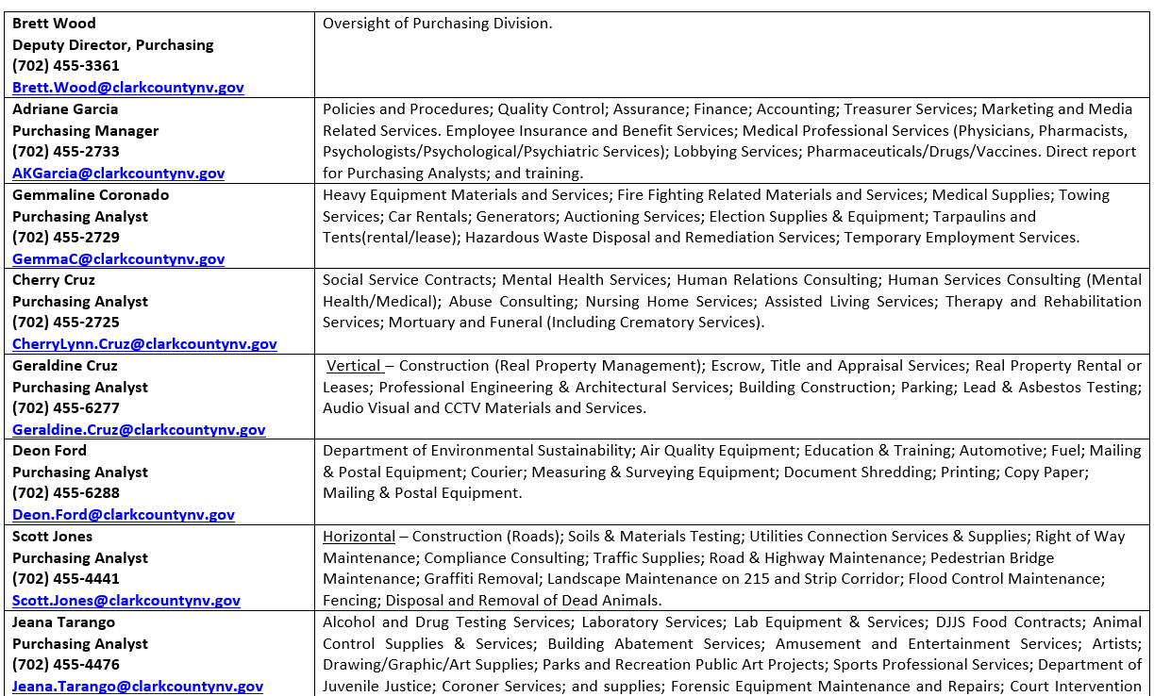
PURCHASING STAFF

Slide 26
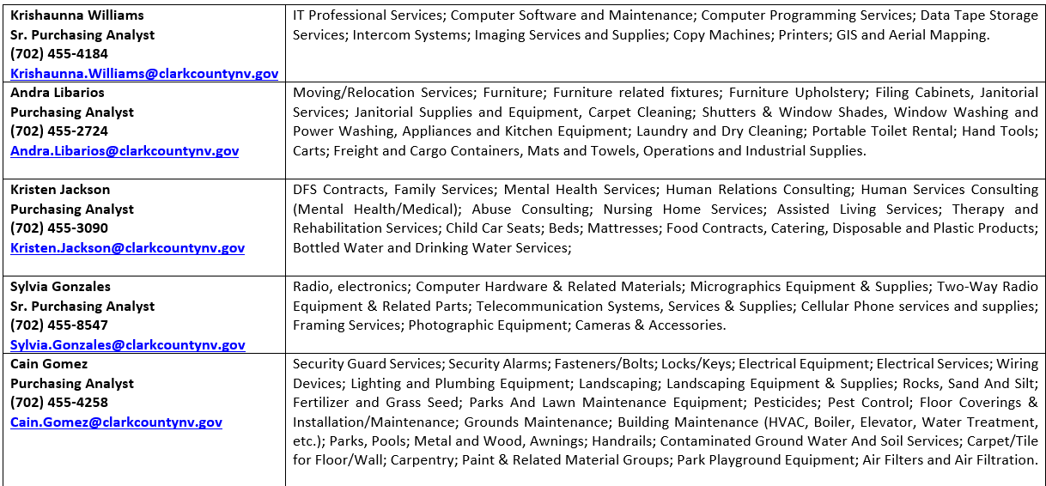
PURCHASING STAFF CONT.

Slide 27
QUESTIONS
?

